Slide 1
CMPSC 100
Computational Expression

Slide 2
Object Oriented Programming: what?!
Java is an object-oriented programming (OOP) language.
We often remark that “everything is an object.” But what do we mean?
Each Java object (“class”) is made up of “properties,” or “attributes.”
Each of these model “states” or “behaviors”
Think of objects, then, as “describing” how something looks, works, behaves, and changes.

Slide 3
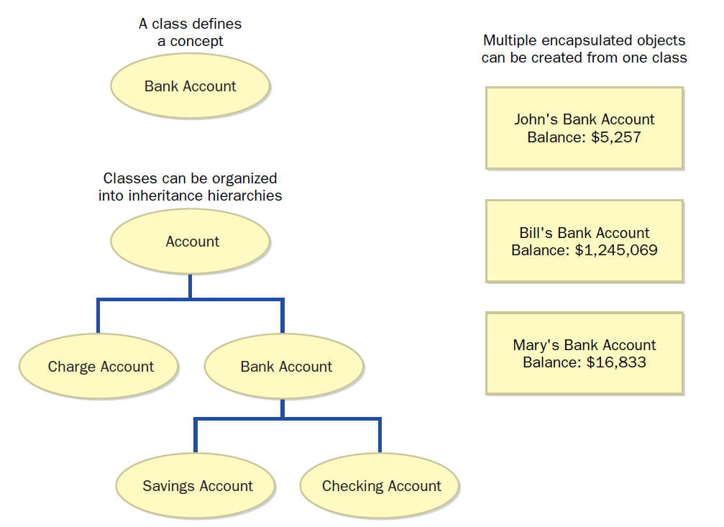
Prof. Luman’s Bank Account
Balance: $-10 x 10⁶

Slide 4
So what have we learned?
Object-oriented programming means:
Creating software which models real or imaginary concepts which have:
States
Behaviors
Attributes
Making these objects as “common” as possible: that is, “abstracting” what a “bank account” is so that
Objects can be reused and combined in ways to create other objects which model other concepts

Slide 5
So, let’s try it out!
Each group should have:
1 suit of playing cards from a deck of cards
Your groups’ job is to create the definition of a “playing card”
Our class’ goal is to combine these various “card” objects into a “deck”

Slide 6
Objects in Java
Class declaration
public class GreetWorld{
public static void main(String[] args){
String greeting = “Greetings, World!”;
System.out.println(greeting);
}
}
Method declaration
Identifer
Value
Statement

Slide 7
public class HelloWorld
{
public static void main (String[] args) {
String greeting
=
"Greetings, World!";
System.out.println(
greeting
);
}
}

Slide 8
Conventions
Like language, there exist certain agreements to enhance legibility and understanding.
Take, for example, the following sentence:
Colorless green ideas sleep furiously.
Code also has conventions, such as:
Spacing
Use of white space
Names for identifiers

Slide 9
Conventions
A test of identifers:
RESULT
result
12345
x12345y
black&yellow
answer_7

